Slide 1
CHAPTER II GENERAL NETWORK DESIGN

Slide 2
CHƯƠNG II : GENERAL NETWORK DESIGN
TOPICS
Step by step network design
Identifying Customer Design Requirements
Characterizing the Existing Network

Slide 3
CHƯƠNG II : GENERAL NETWORK DESIGN
Business forces affecting decisions for the enterprise network include the following:
Return on investment
Regulation
Competitiveness
Removal of borders
Virtualization
Growth of applications

Slide 4
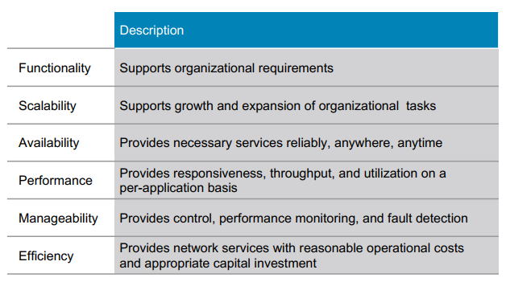
CHƯƠNG II : GENERAL NETWORK DESIGN

Slide 5
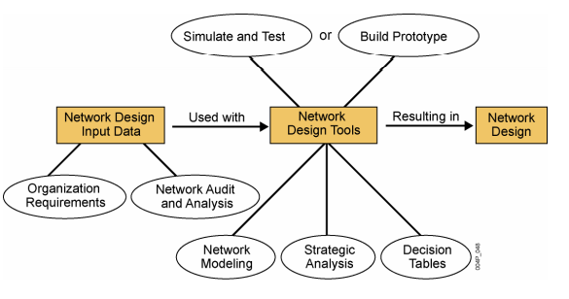
CHƯƠNG II : GENERAL NETWORK DESIGN

Slide 6
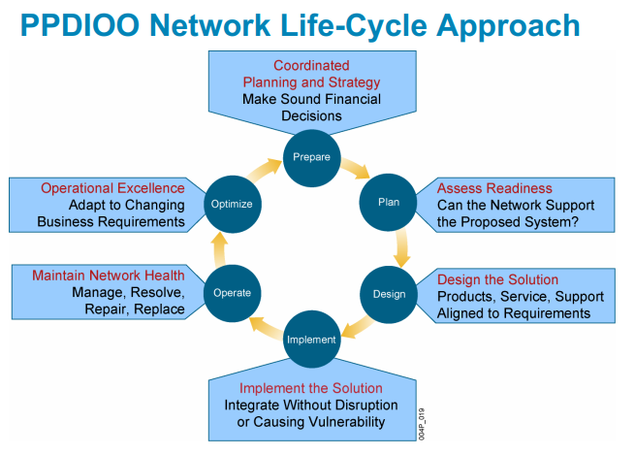
CHƯƠNG II : GENERAL NETWORK DESIGN
I - Step by step network design

Slide 7
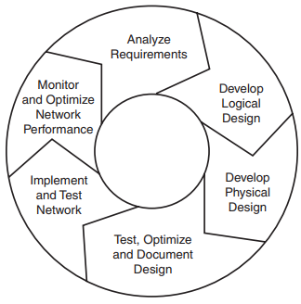
CHƯƠNG II : GENERAL NETWORK DESIGN
I - Step by step network design

Slide 8
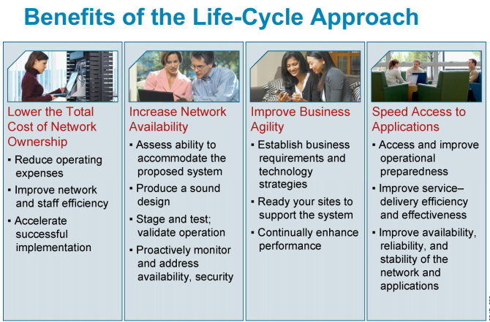
CHƯƠNG II : GENERAL NETWORK DESIGN
II - Step by step network design

Slide 9
CHƯƠNG II : GENERAL NETWORK DESIGN
I - Step by step network design
Prepare Phase - Identify the customer requirements
Organization and business requirements
Develops a network strategy and
Proposes a high-level conceptual architecture
Financial justification

Slide 10
CHƯƠNG II : GENERAL NETWORK DESIGN
I - Prepare, Plan, Design, Implement, Operate, and Optimize
Plan Phase - Characterize the existing network and sites
Identifies the network requirements based on goals, facilities, and user needs.
Characterizes sites and assesses the network (Upgrade)
Performs a gap analysis against best-practice architectures
Look at the operational environment., the scope, cost, and resource parameters.
This project plan is followed (and updated) during all phases of the cycle.

Slide 11
CHƯƠNG II : GENERAL NETWORK DESIGN
I - Prepare, Plan, Design, Implement, Operate, and Optimize
Design Phase - Design the topology and network solutions
The network design is developed based on the technical and business requirements obtained from the previous phases.
The network design specification is a comprehensive detailed design that meets current business and technical requirements.
It provides high availability, reliability, security, scalability, and performance.
The design includes network diagrams and an equipment list.
The project plan is updated with more granular information for implementation.

Slide 12
CHƯƠNG II : GENERAL NETWORK DESIGN
I - Prepare, Plan, Design, Implement, Operate, and Optimize
Implement Phase
New equipment is installed and configured (replace or augment the existing infrastructure)
Planned network changes should be communicated in change control meetings
Each step in the implementation should includes a description, Detailed implementation guidelines, estimated time to implement, rollback steps in case of a failure
Testing before moving to the Operate phase.

Slide 13
CHƯƠNG II : GENERAL NETWORK DESIGN
I - Prepare, Plan, Design, Implement, Operate, and Optimize
Operate Phase
Maintains the network’s day-to-day operational health. Managing, monitoring network components, routing maintenance, managing upgrades, managing performance, and identifying and correcting network faults.
During operation, network management stations should monitor the network’s general health and generate traps when certain thresholds are reached. Fault detection, correction, and performance monitoring events provide initial data for the optimize phase.

Slide 14
CHƯƠNG II : GENERAL NETWORK DESIGN
I - Prepare, Plan, Design, Implement, Operate, and Optimize
Optimize Phase
The Optimize phase involves proactive network management by identifying and resolving issues before they affect the network. The Optimize phase may create a modified network design if too many network problems arise, to improve performance issues, or to resolve application issues. The requirement for a modified network design leads to the network life cycle beginning.

Slide 15
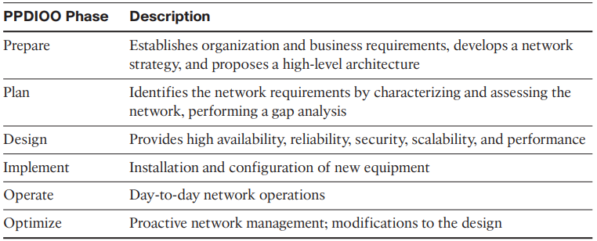
CHƯƠNG II : GENERAL NETWORK DESIGN
I - Step by step network design

Slide 16
CHƯƠNG II : GENERAL NETWORK DESIGN
II - Identifying Customer Requirements
Step 1. Identify network applications and services.
Step 2. Define the organizational goals.
Step 3. Define the possible organizational constraints. Step 4. Define the technical goals.
Step 5. Define the possible technical constraints.

Slide 17
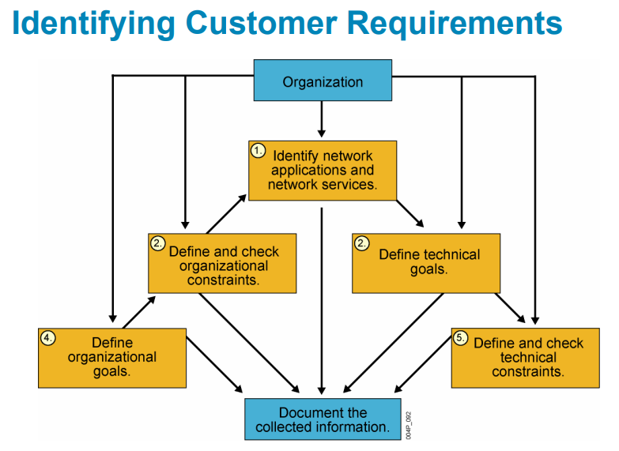
CHƯƠNG II : GENERAL NETWORK DESIGN
II - Identifying Customer Requirements

Slide 18
CHƯƠNG II : GENERAL NETWORK DESIGN
II - Identifying Customer Requirements
Step 1. Identify network applications and services.
Planned application types: Such as email, collaboration, voice, web browsing, file sharing, database
Concrete applications: Such as Outlook, MeetingPlace
Business importance: Labeled as critical, important, or unimportant
Comment: Any additional information critical to the design of the network

Slide 19
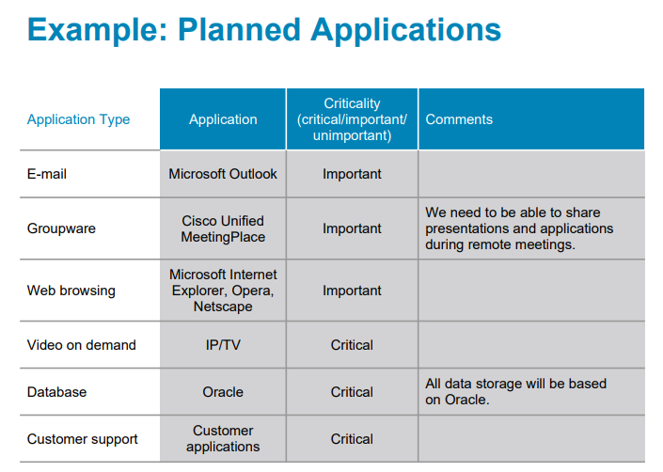
CHƯƠNG II : GENERAL NETWORK DESIGN
II - Identifying Customer Requirements

Slide 20
CHƯƠNG II : GENERAL NETWORK DESIGN
II - Identifying Customer Requirements
Step 1. Identify network applications and services.
Planned infrastructure services should also be gathered. Network services include security, quality of service (QoS), network management, high availability, unified communications, mobility, and virtualization.

Slide 21
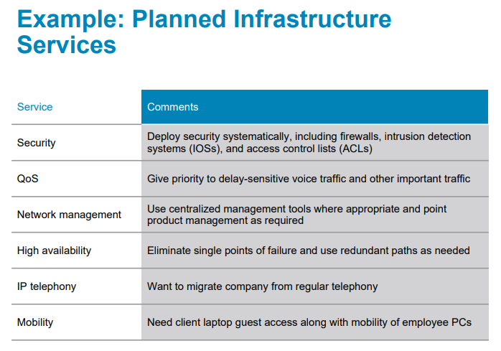
CHƯƠNG II : GENERAL NETWORK DESIGN
II - Identifying Customer Requirements

Slide 22
CHƯƠNG II : GENERAL NETWORK DESIGN
II - Identifying Customer Requirements
Step 2. Define the organizational goals.
For organizational goals, you should identify whether the company’s goal is to improve customer support, add new customer services, increase competitiveness, or reduce costs. It might be a combination of these goals, with some of them being more important than others.

Slide 23
CHƯƠNG II : GENERAL NETWORK DESIGN
II - Identifying Customer Requirements
Step 2. Define the organizational goals.
■ Increase revenue and profit ■ Increase market share ■ Expand into new markets ■ Increase competitive advantages over companies in the same market ■ Reduce costs ■ Increase employee productivity

Slide 24
CHƯƠNG II : GENERAL NETWORK DESIGN
II - Identifying Customer Requirements
Step 2. Define the organizational goals.
■ Shorten product-development cycles ■ Use just-in-time manufacturing ■ Plan around component shortages ■ Offer new customer services ■ Offer better customer support ■ Open the network to key constituents (prospects, investors, customers, business partners, suppliers, and employees) ■ Avoid business disruption caused by network security problems

Slide 25
CHƯƠNG II : GENERAL NETWORK DESIGN
II - Identifying Customer Requirements
Step 2. Define the organizational goals.
■ Avoid business disruption caused by natural and unnatural disasters ■ Modernize outdated technologies ■ Reduce telecommunications and network costs, including overhead associated with separate networks for voice, data, and video ■ Make data centers more efficient in their usage of power, cabling, racks, storage, and WAN circuits ■ Comply with IT architecture design and governance goals

Slide 26
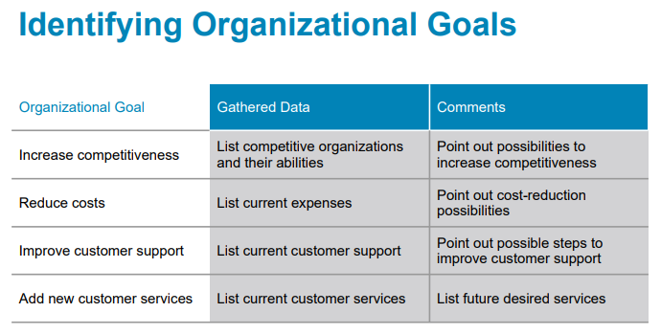
CHƯƠNG II : GENERAL NETWORK DESIGN
II - Identifying Customer Requirements
Step 2. Define the organizational goals.

Slide 27
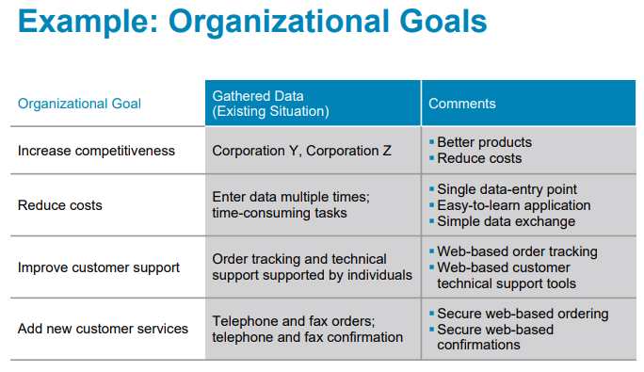
CHƯƠNG II : GENERAL NETWORK DESIGN
II - Identifying Customer Requirements
Step 2. Define the organizational goals.

Slide 28
CHƯƠNG II : GENERAL NETWORK DESIGN
II - Identifying Customer Requirements
Step 3. Define the organizational constraints.
Organizational constraints include budget, personnel, policy, and schedule. The company might limit you to a certain budget or timeframe. The organization might require the project to be completed in an unreasonable timeframe. It might have limited personnel to support the assessment and design efforts, or it might have policy limitations to use certain protocols.

Slide 29
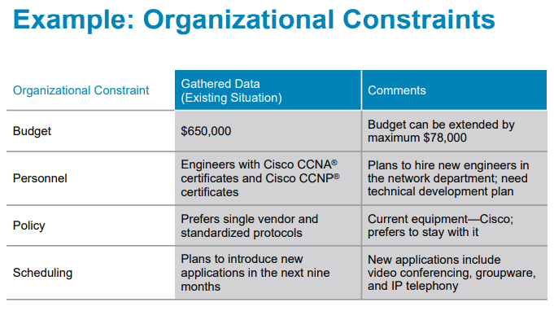
CHƯƠNG II : GENERAL NETWORK DESIGN
II - Identifying Customer Requirements
Step 3. Define the organizational constraints.

Slide 30
CHƯƠNG II : GENERAL NETWORK DESIGN
II - Identifying Customer Requirements
Step 4. Define the technical goals.
■ Improve the network’s response-time throughput
■ Decrease network failures and downtime (high availability)
■ Simplify network management

Slide 31
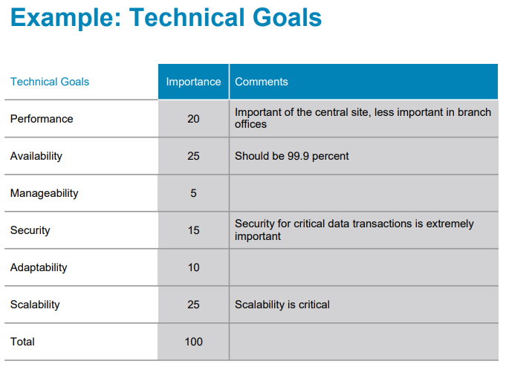
CHƯƠNG II : GENERAL NETWORK DESIGN
II - Identifying Customer Requirements
Step 4. Define the technical goals.

Slide 32
CHƯƠNG II : GENERAL NETWORK DESIGN
II - Identifying Customer Requirements
Step 4. Define the technical goals.
■ Improve network security
■ Improve reliability of mission-critical applications
■ Modernize outdated technologies (technology refresh)
■ Improve the network’s scalability

Slide 33
CHƯƠNG II : GENERAL NETWORK DESIGN
II - Identifying Customer Requirements
Step 5. Define the possible technical constraints.
■ Existing wiring does not support new technology.
■ Bandwidth might not support new applications.
■ The network must support exiting legacy equipment.
■ Legacy applications must be supported (application compatibility).

Slide 34
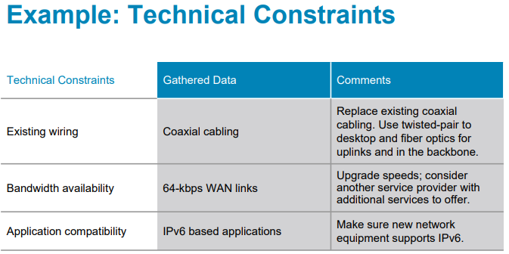
CHƯƠNG II : GENERAL NETWORK DESIGN
II - Identifying Customer Requirements
Step 5. Define the possible technical constraints.

Slide 35
CHƯƠNG II : GENERAL NETWORK DESIGN
II - Identifying Customer Requirements
Summary
Systematic approach
Focus first on business requirements and constraints, and applications
Gain an understanding of the customer’s corporate structure
Gain an understanding of the customer’s business style

Slide 36
CHƯƠNG II : GENERAL NETWORK DESIGN
III - Characterizing the Existing Network and site
Its infrastructure
Logical structure (modularity, hierarchy, topology)
Physical structure
Addressing and naming
Wiring and media
Architectural and environmental constraints
Health
Traffic

Slide 37
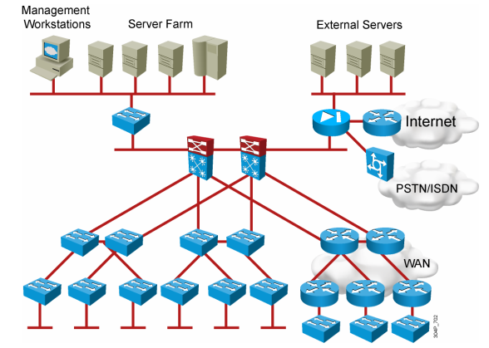
CHƯƠNG II : GENERAL NETWORK DESIGN
III - Characterizing the Existing Network and site
Its infrastructure
Logical structure (modularity, hierarchy, topology)
Physical structure

Slide 38
CHƯƠNG II : GENERAL NETWORK DESIGN
III - Characterizing the Existing Network and site
Addressing and naming
IP addressing for major devices, client networks, server networks, and so on
Any addressing oddities, such as discontiguous subnets?
Any strategies for addressing and naming?

Slide 39
CHƯƠNG II : GENERAL NETWORK DESIGN
III - Characterizing the Existing Network and site
Wiring and media
Single-mode fiber
Multi-mode fiber
Shielded twisted pair (STP) copper
Unshielded-twisted-pair (UTP) copper
Coaxial cable
Microwave
Laser
Radio
Infra-red

Slide 40
CHƯƠNG II : GENERAL NETWORK DESIGN
III - Characterizing the Existing Network and site
Architectural and environmental constraints
Air conditioning
Heating
Ventilation
Power
Protection from electromagnetic interference
Doors that can lock

Slide 41
CHƯƠNG II : GENERAL NETWORK DESIGN
III - Characterizing the Existing Network and site
Architectural and environmental constraints
Make sure there’s space for:
Cabling conduits
Patch panels
Equipment racks
Work areas for technicians installing and troubleshooting equipment

Slide 42
CHƯƠNG II : GENERAL NETWORK DESIGN
III - Characterizing the Existing Network and site
Architectural and environmental constraints
Issues for Wireless Installations:
Reflection
Absorption
Refraction
Diffraction

Slide 43
CHƯƠNG II : GENERAL NETWORK DESIGN
III - Characterizing the Existing Network and site
Health
Performance
Availability
Bandwidth utilization
Accuracy
Efficiency
Response time
Status of major routers, switches, and firewalls

Slide 44
CHƯƠNG II : GENERAL NETWORK DESIGN
III - Characterizing the Existing Network and site
Traffic
Traffic flow
Location of traffic sources and data stores
Traffic load
Traffic behavior
Quality of Service (QoS) requirements

Slide 45
CHƯƠNG II : GENERAL NETWORK DESIGN
III - Characterizing the Existing Network and site
Summary
Existing internetwork before designing enhancements
Verify that a customer’s design goals are realistic
Helps you locate where new equipment will go
Cover yourself if the new network has problems due to unresolved problems in the old network

Slide 46
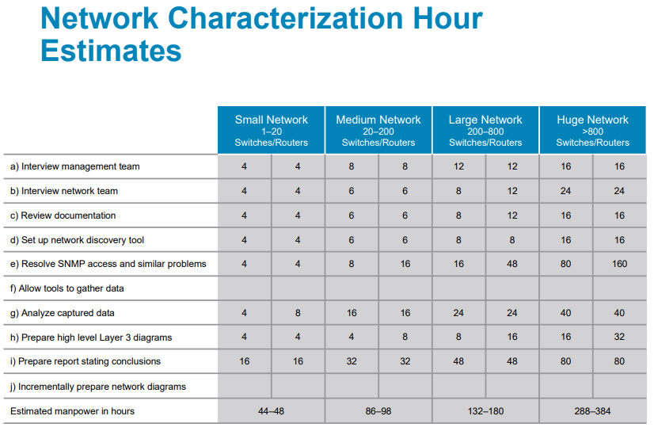
CHƯƠNG II : GENERAL NETWORK DESIGN
III - Characterizing the Existing Network and site

Slide 47
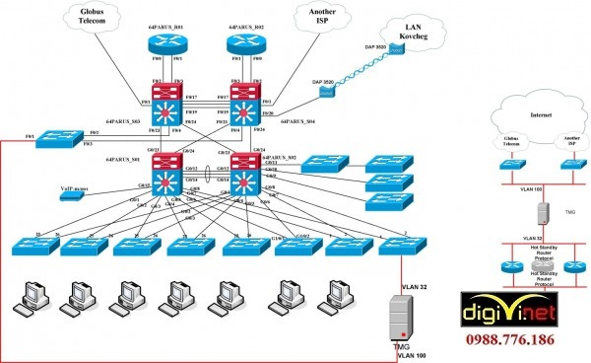
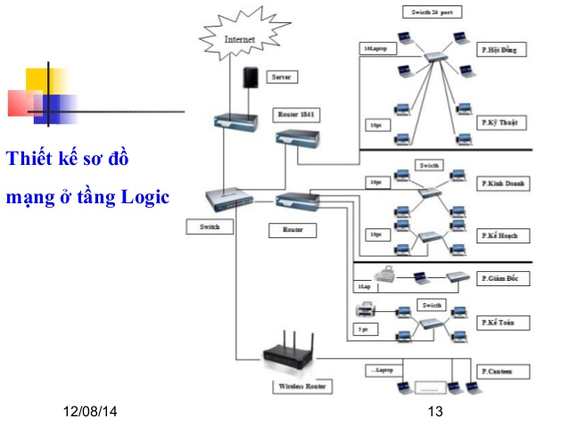
END CHAPTER

